Slide 1





BLOOD DR﻿OPLET
WE SAVE LIVES

Slide 2
SUPERVISED BY:
Dr. Samar Hesham
Lecturer, Department of Information Technology at EELU
Ta. Hussein Zayed
Department of Information Technology at EELU

Slide 3
OUR TEAM
Mohamed Emad Daleb
Youssef Abdallah Kamal
Ahmed Waheed Shatat
Mahmoud Mabrouk
Youseef Rabea El-Afify
Ahmed Amin Elgamal
Moaz Gamal Mostafa
graduation Project Academic Year 2023-2024
Presentation

Slide 4
agenda
Introduction
Challenge
Problem statement
Related work
Proposed solution
Phase 1
Implementation
References

Slide 5


INTRODUCTION

Slide 6
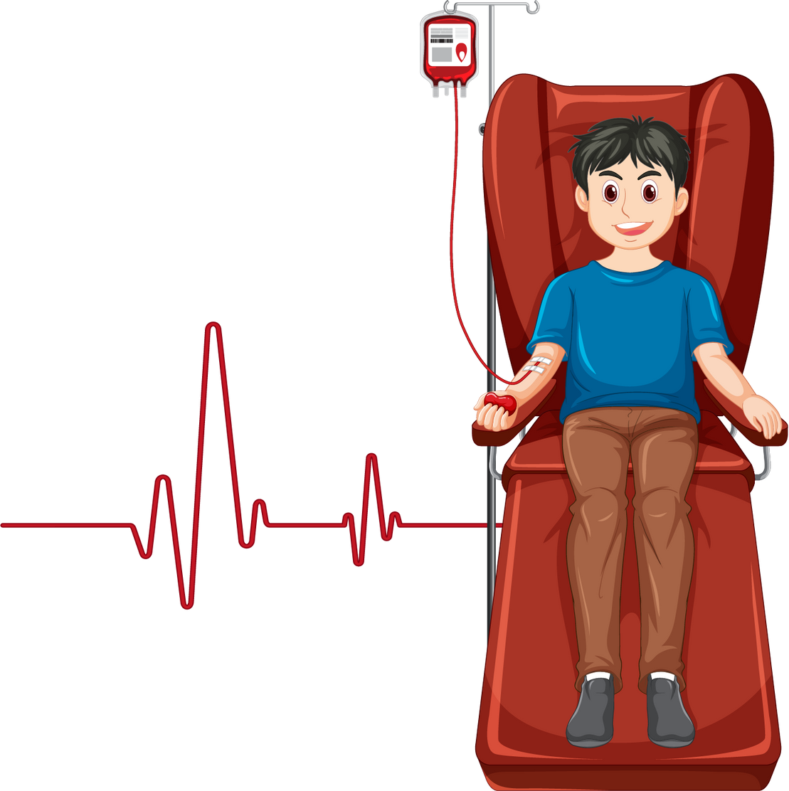

World Health Organization
Egypt's Struggle to Meet Global Standards
Global Standard: Ideally, blood donation should be 3-5% of the population globally.
Egypt's Target: Egypt should ideally collect 3 to 5 million blood bags annually.
Reality Check: In actuality, only about 2 million blood bags are collected annually in Egypt, significantly below the ideal rate.

Slide 7
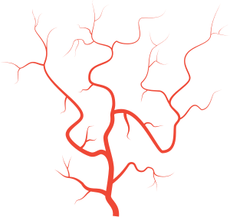
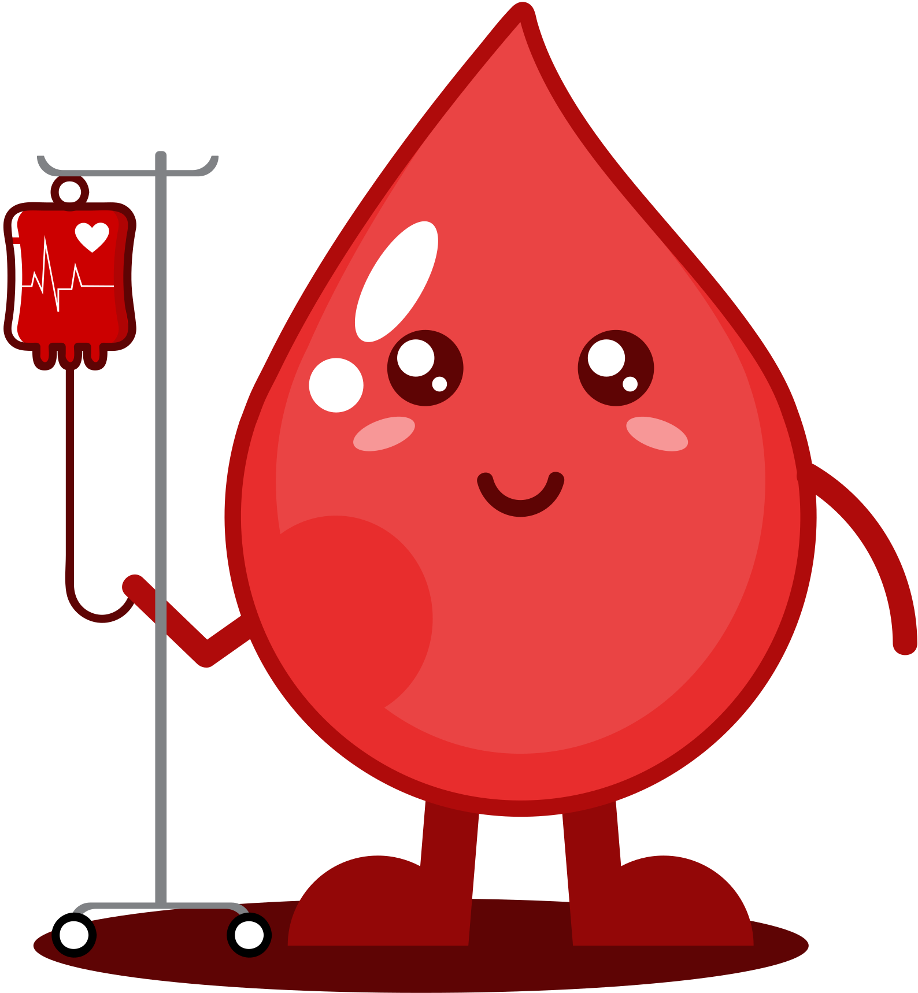

Blood Bag Shortage Threatens 15% of Patients
Annual Deficit: The Ministry of Health confirms a shortfall of 300,000 bags.
Shortage Threat: Puts 15% of patients' lives at risk.
Lack of Awareness: A major factor leading to the disappearance of rare blood types.
Priority: Administrators stress the immediate need to secure blood types for 85% of patients.

Slide 8

Blood Preparedness Assurance at Al Moneera Hospital:
Al Moneera Hospital's Blood Preparedness:
15 bags for common blood types
2 bags for rare types
Collaboration with regional blood bank for extra needs

Slide 9

CHALLENGES
Blood Shortages
Access to remote areas
Life-Threatening Consequences

Slide 10

PROBLEM STATMENT
Difficulty for the donor to reach blood banks where his type is not available
Difficulty in the patient’s access to blood banks that carry his type
Notes:
هنا هنقول ان التحدي بتاعنا اننا نعمل كذا ونقلل المخاطر وغيره بس المشاكل ال معطله الامور كذا وكذا ف السوفت وير الطرش هيحلها

Slide 11
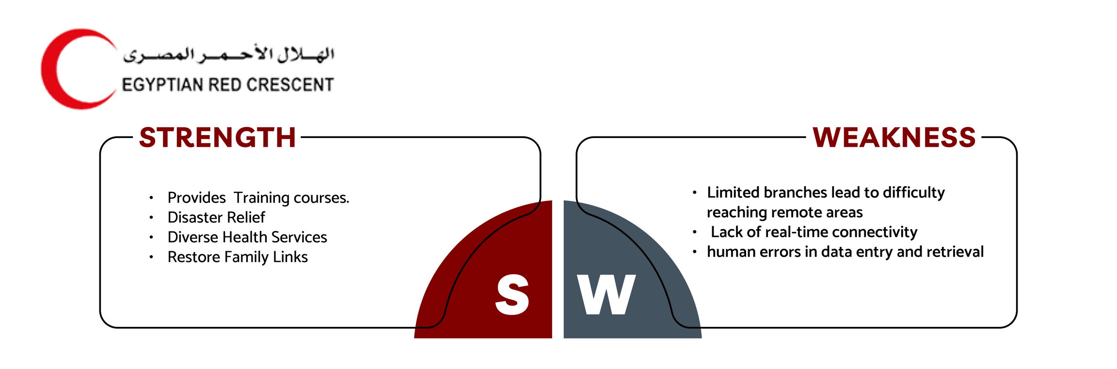
RELATED WORK

Slide 12
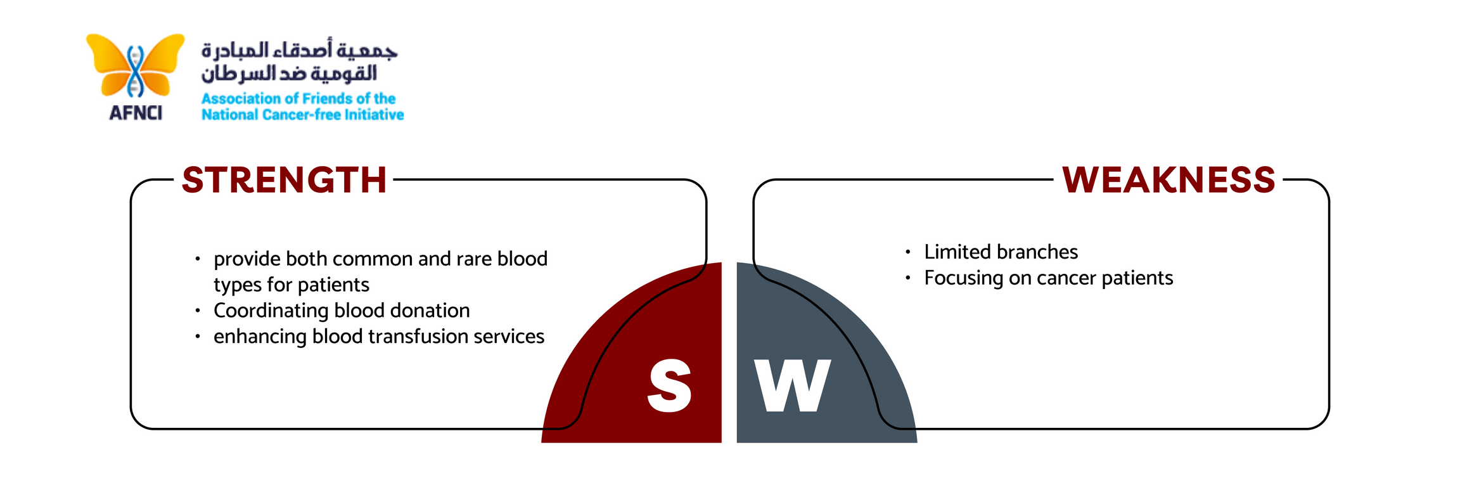
RELATED WORK

Slide 13
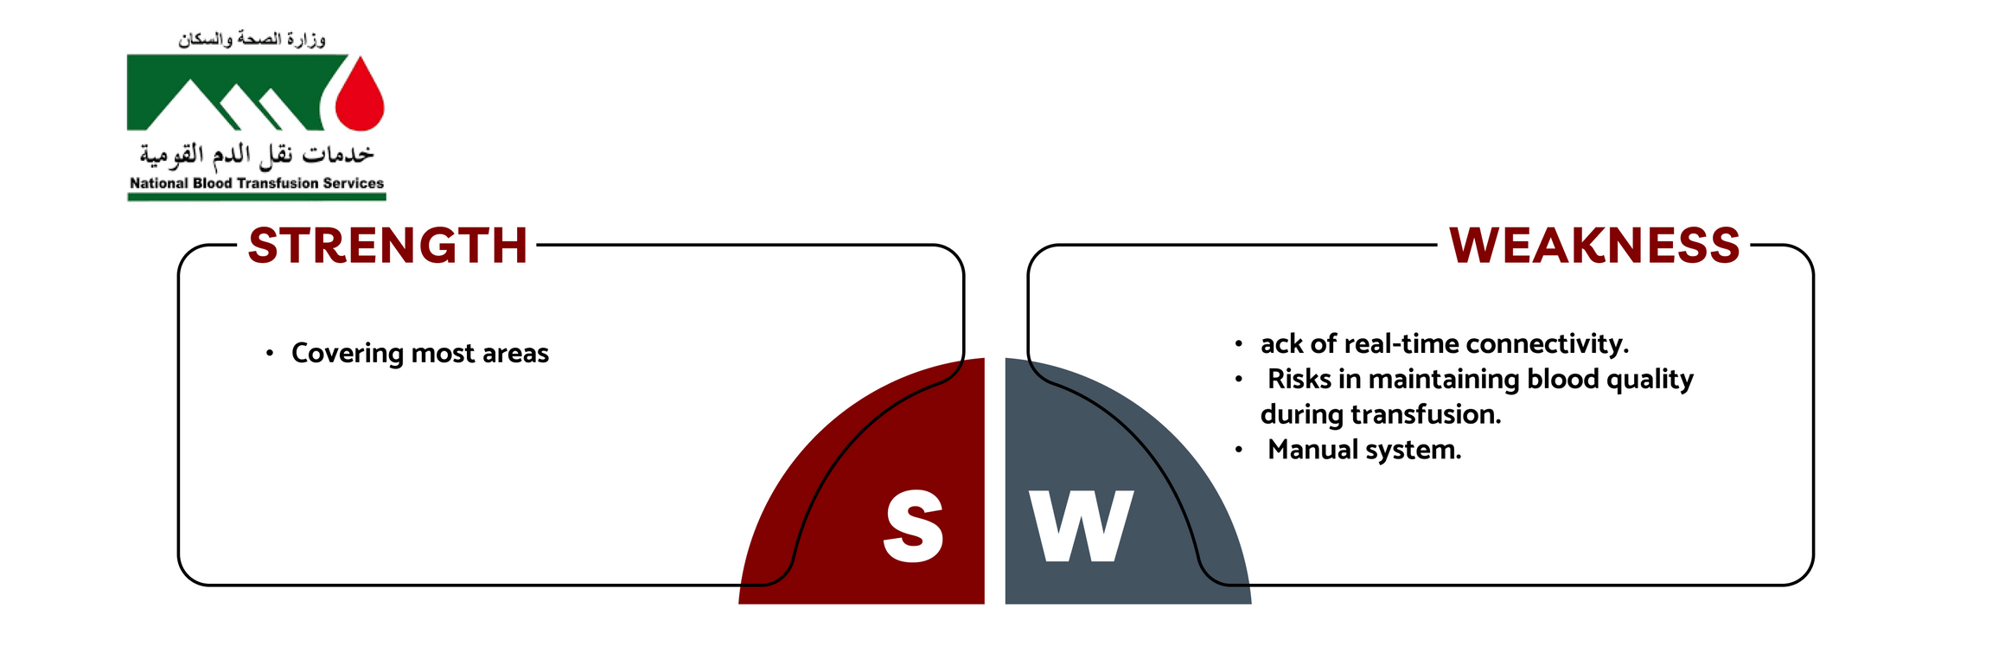
RELATED WORK

Slide 14
BLOOD DR﻿OPLET
A solution to Egypt's Blood Shortages
Aims to centralize and organize data for efficient blood management

Slide 15
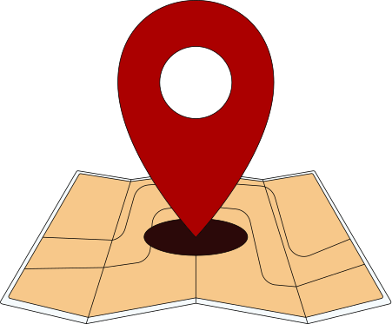
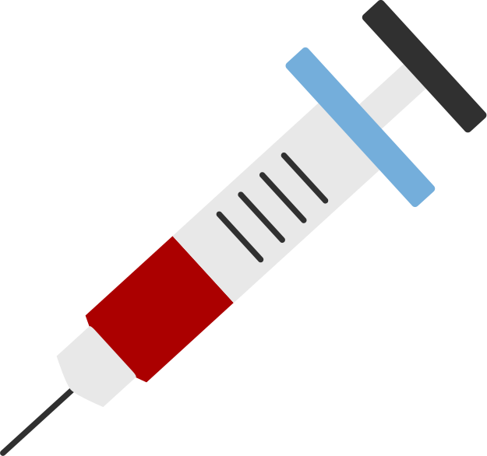
Proposed Solution
Find out the Nearest
Hospital or Blood Bank
Blood Donation

Slide 16
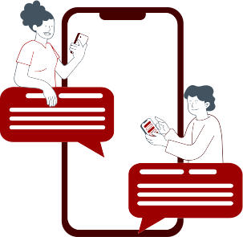

Proposed Solution
ONLINE CHAT WITH THE CUSTOMER SERVICE
Q&A MODEL
PROFILE

Slide 17
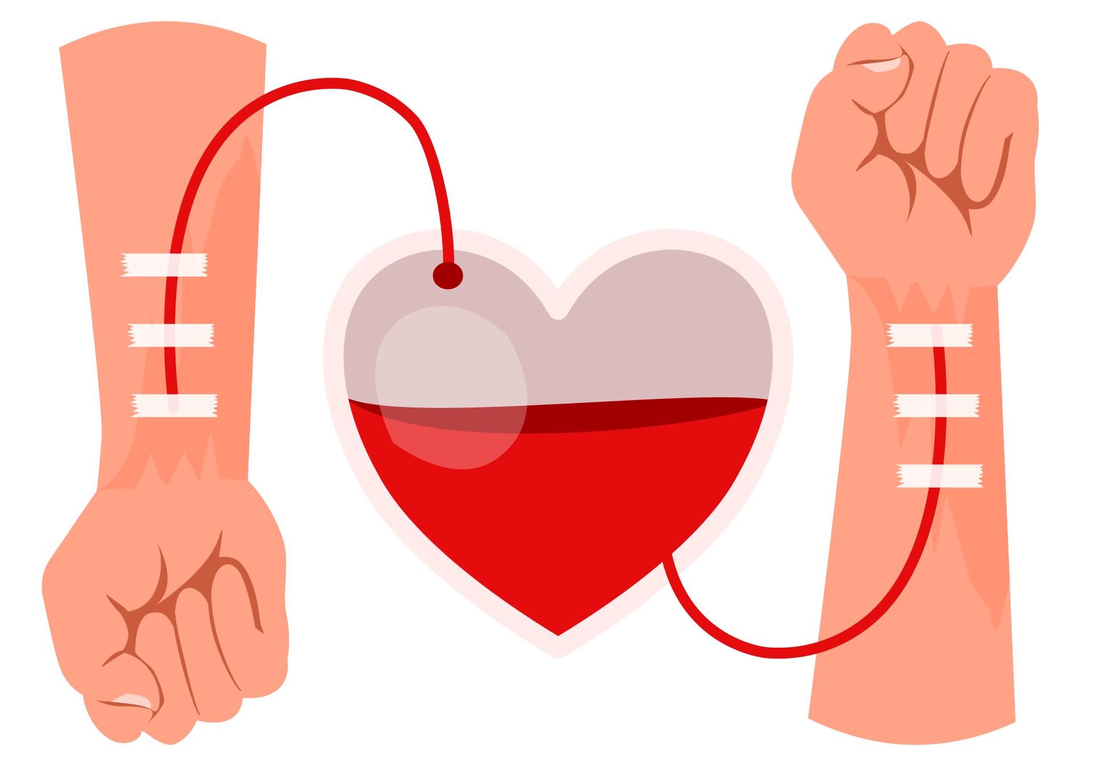

Proposed Solution
HELP
LEARN

Slide 18

Impact on Patients
Faster Treatment: Patients can quickly locate and access the required blood type
Improved Healthcare: enhanced healthcare outcomes

Slide 19

PHASE 1
Timeline
Analysis
Design

Slide 20
TIME PLAN
MONTH | OCTOBER | NOVEMBER | DECEMBER | JANUARY | FEBRUARY | MARCH | APRIL | MAY
RESEARCH
Search for idea (2 weeks)
Reseach about the idea (2 weeks)
REQUIREMENTS
Android
Ui Ux Design & prototyping
HTML , CSS , JS
.NET(Database , #C)
DEVELOPMENT
40%
60%
DEVELOPMENT
INTERGRATION

Slide 21



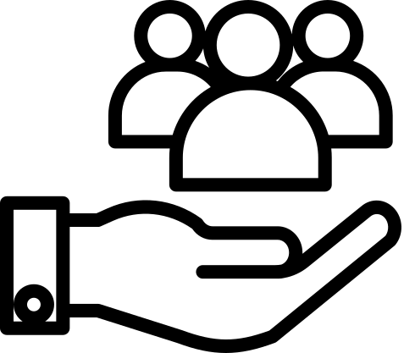




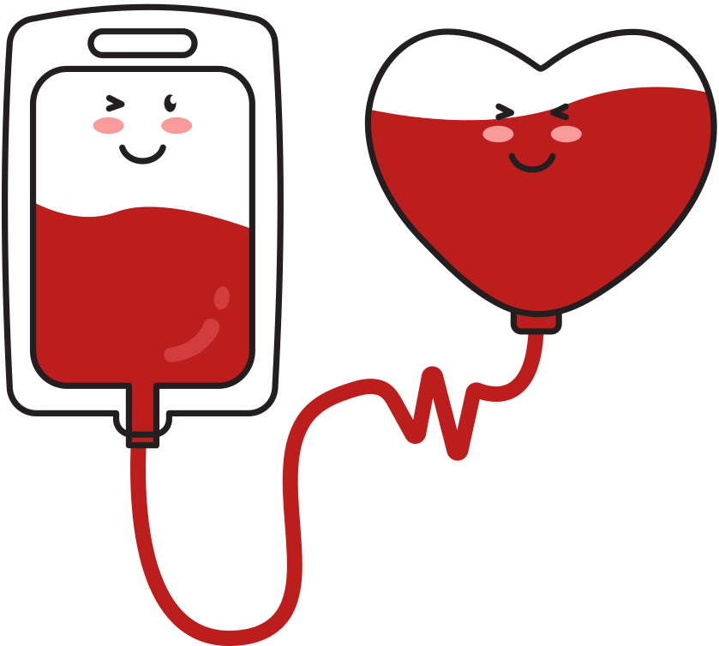
ANALYSIS
Business Model Canvas
Key Partners
Key Activities
Value Proportions
Customer Relationships
Customer Segments
1-Find out the nearest hospital or blood bank
2- grants and privileges for donors
3- obtaining the specified blood type and quantity
4-blood donation
1-Continuous blood supply
2- Granting privileges to donors
3- Providing a database with the names of institutes and hospitals where donations can be made
1- Hospitals
2- Institutes
3- Blood banks
4- Investors
1- High automated
2- High degree of privacy
3- Granting privileges to donor
4-Providing Blood Continously
1- Hospitals
2- Blood Bank
3- Donors
4- patient
Key Resources
Channels
1- Website
2- mobile app
3- Donors
4- Data Center
1- Web Application
( BloodBank.com )
2- Mobile Application
( Blood Bank )
Cost Structure
Revenue Streams
1- Marketing Cost
2- Servers Cost
2- Collect Data
1-Partnership with hospitals and institutes
2- Partnership with private medical centers

Slide 22

System Analysis
Context Diagram
DFD
Use Case

Slide 23
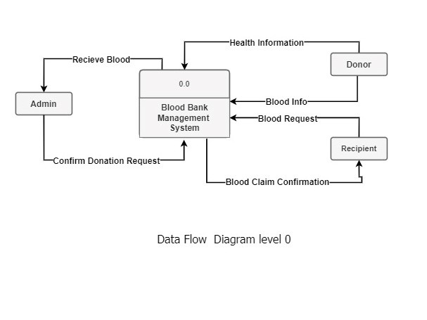
CONTEXT DIAGRAM

Slide 24
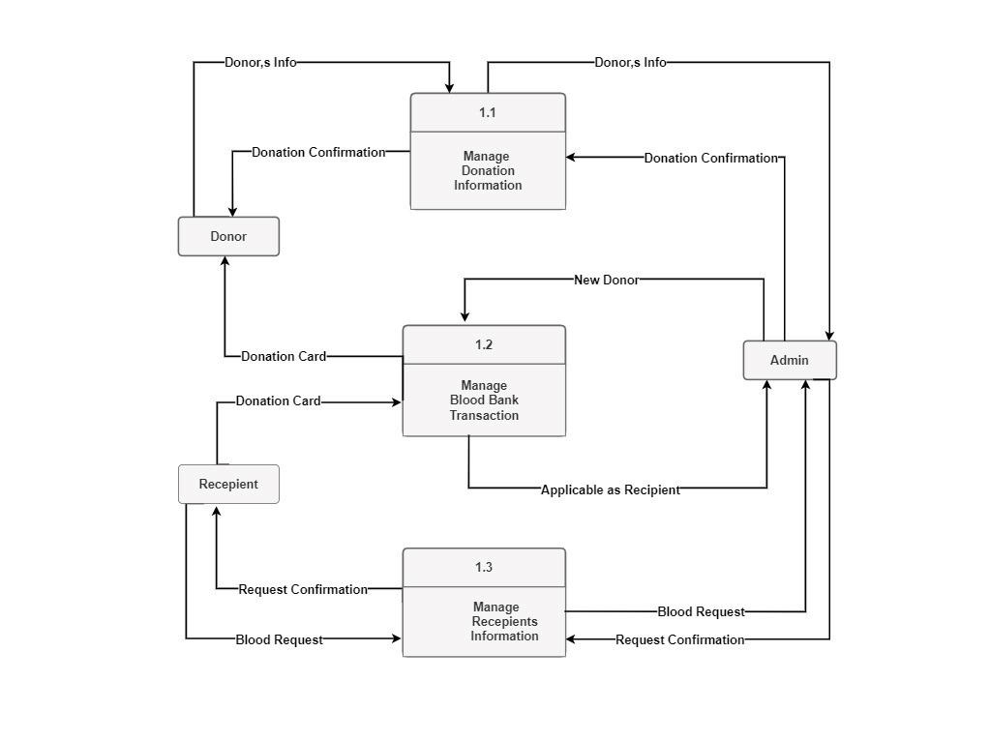
DFD LEVEL 1

Slide 25
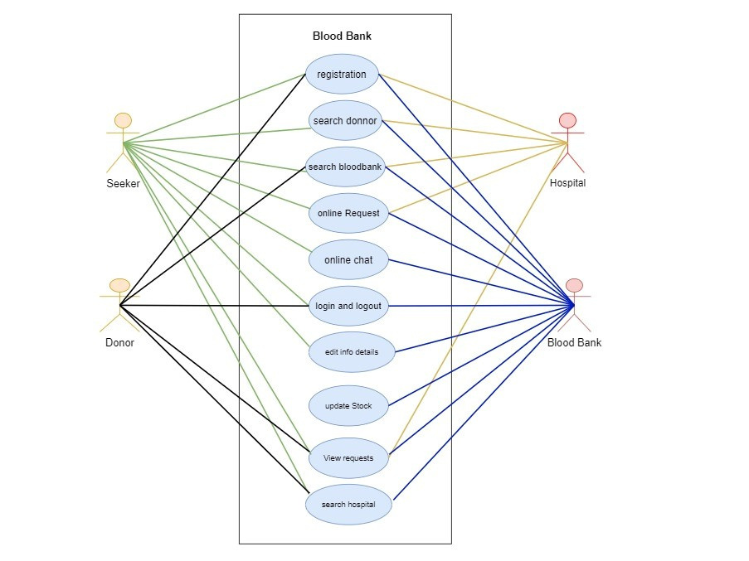
USE CASE

Slide 26
Design System
ERD
Brand Guidelines
UX/UI

Slide 27
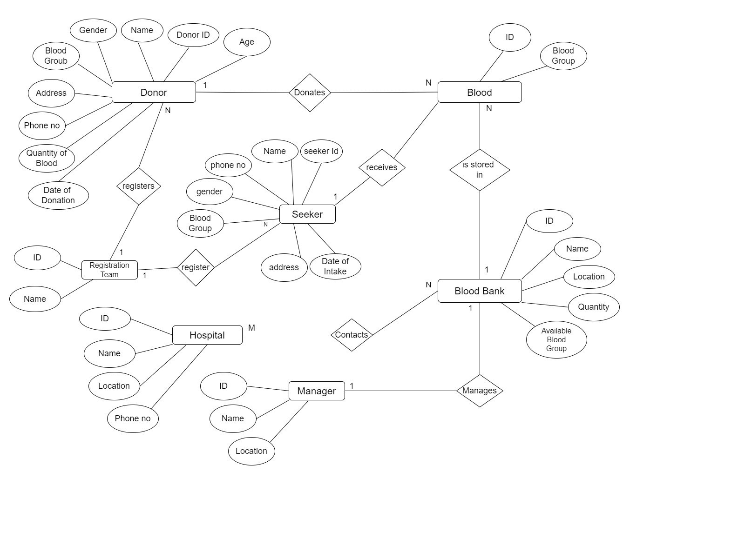
ERD

Slide 28
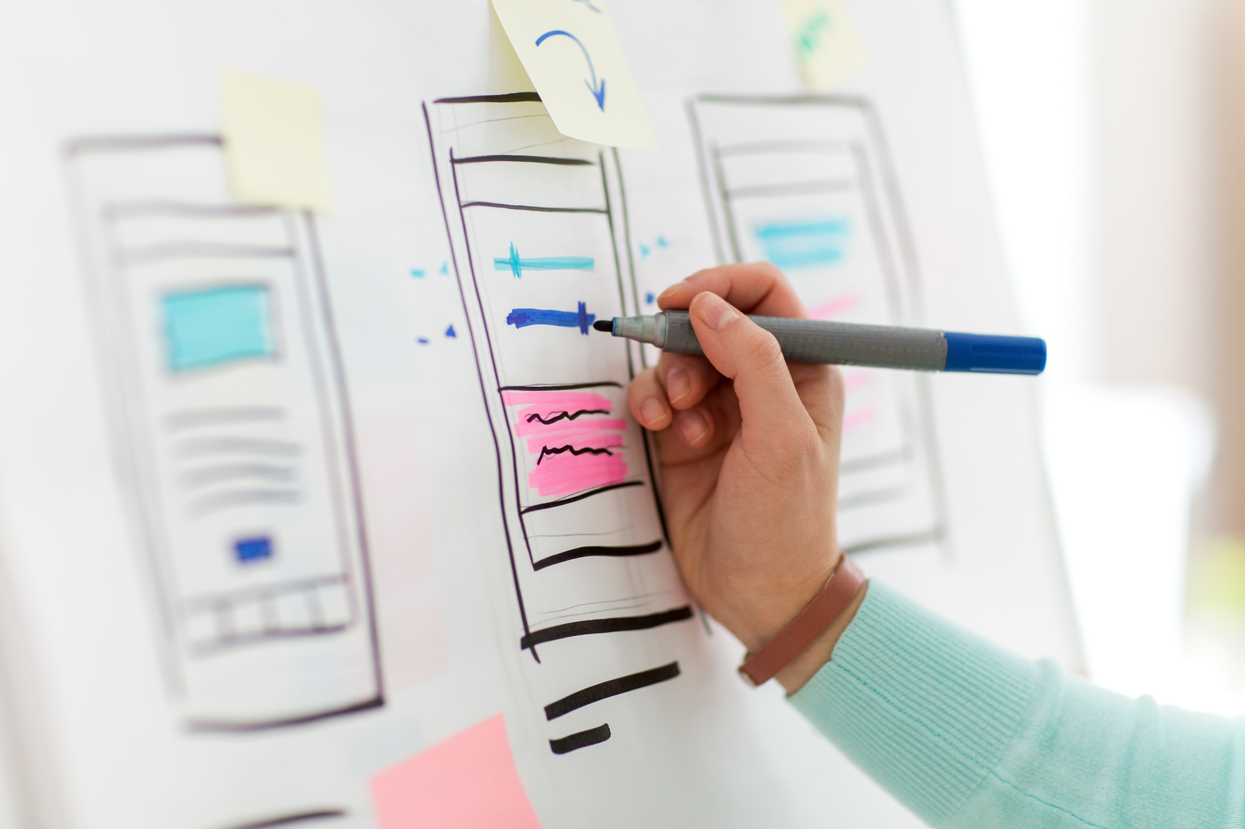
INTERFACE

Slide 29
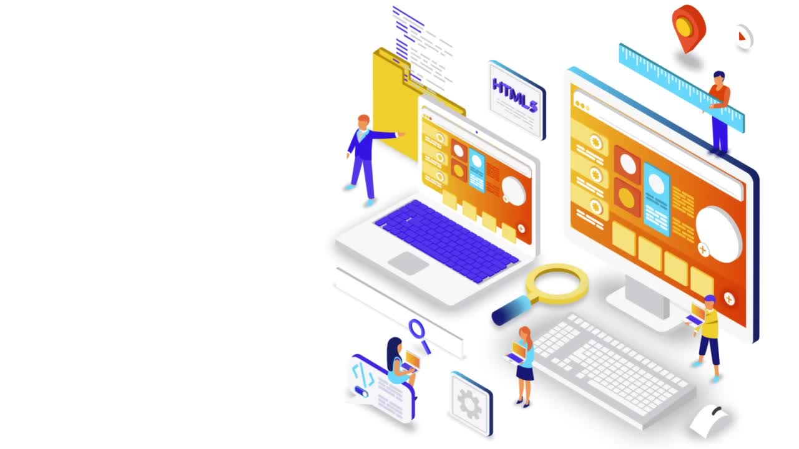

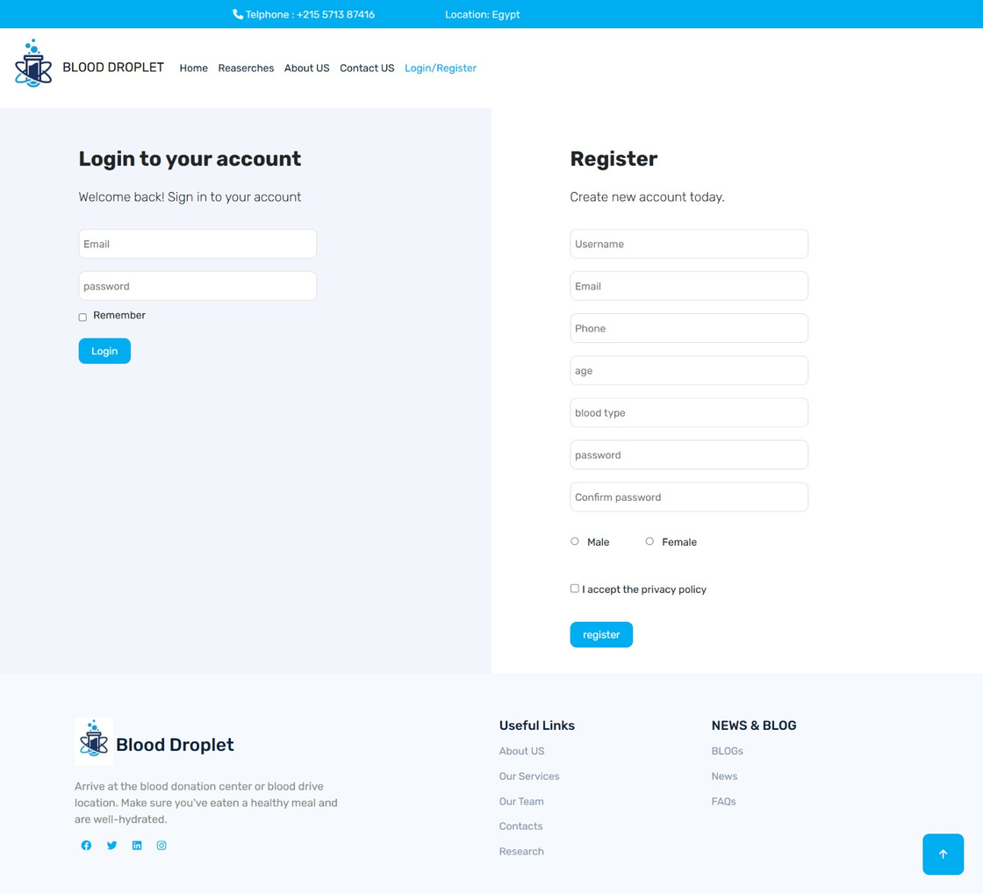
UI
WEBSITE

Slide 30
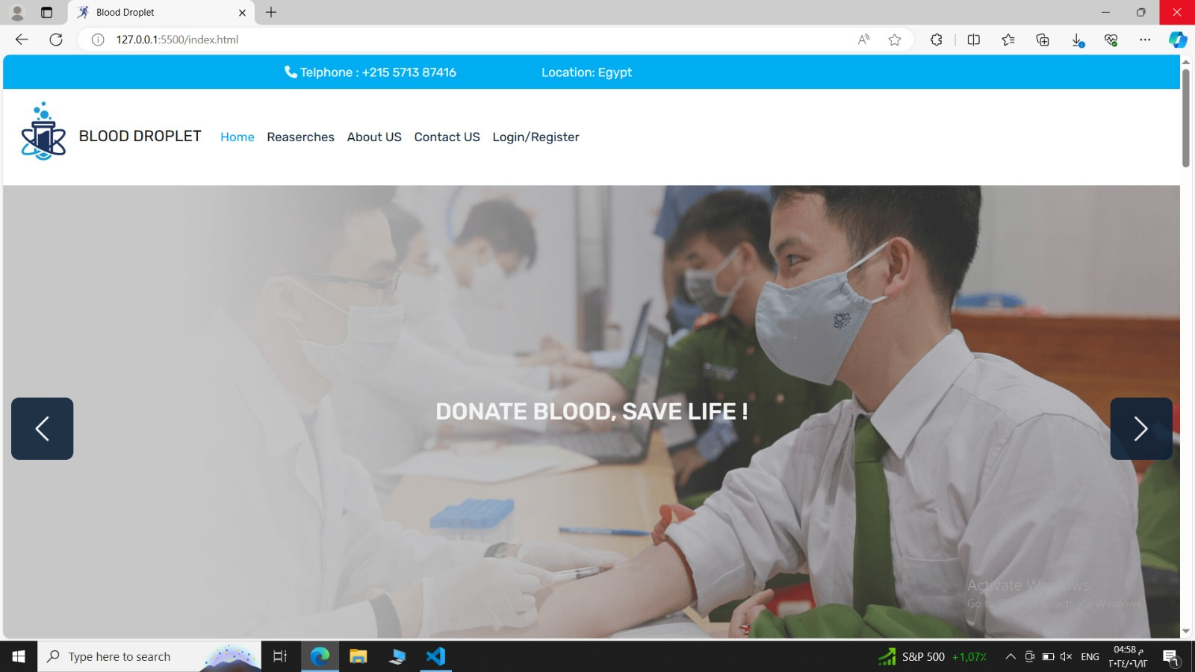
UI
WEBSITE

Slide 31
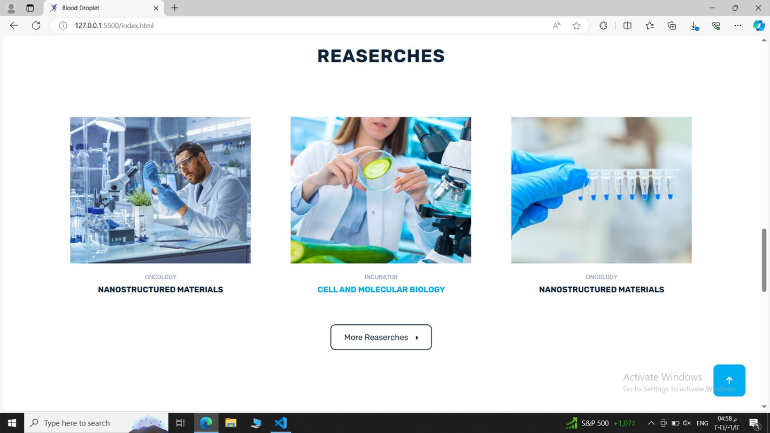
UI
WEBSITE

Slide 32
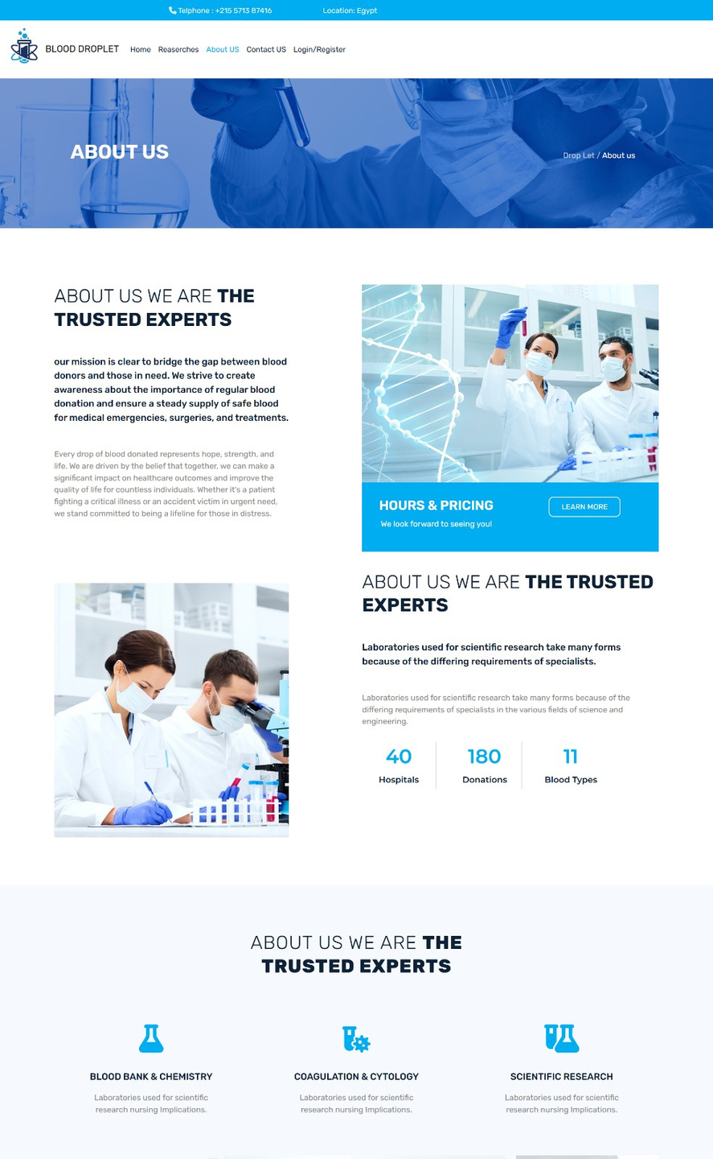
UI
WEBSITE

Slide 33
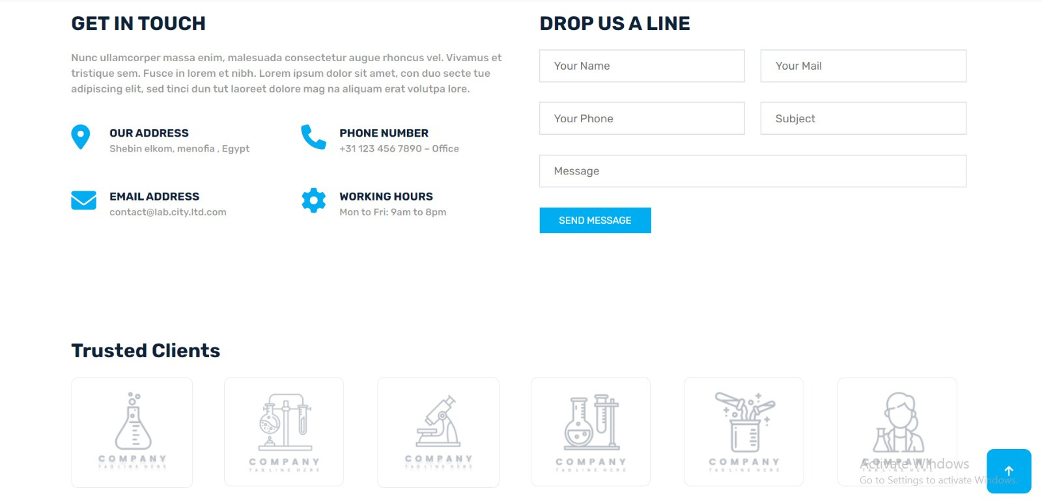
UI
WEBSITE

Slide 34

IMPLEMENTATION

Slide 35
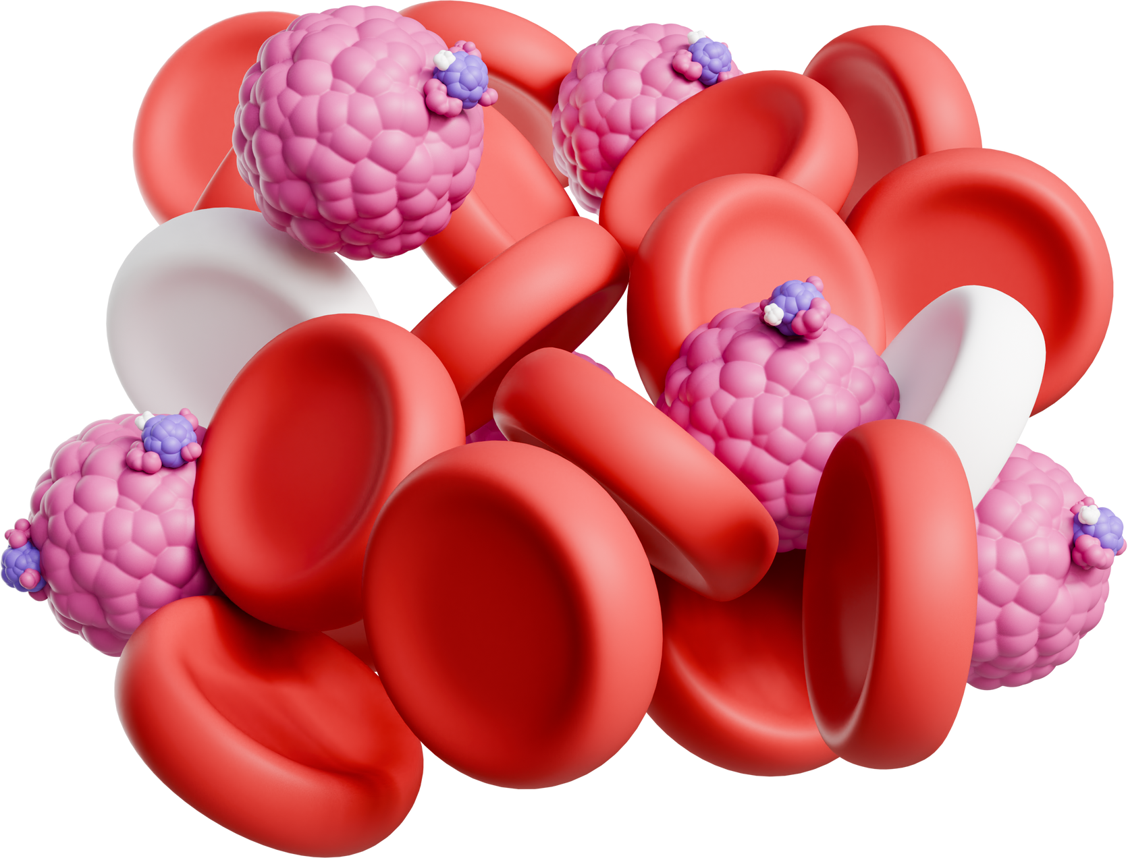
Login
Register
Land page
Donation
Search

Slide 36

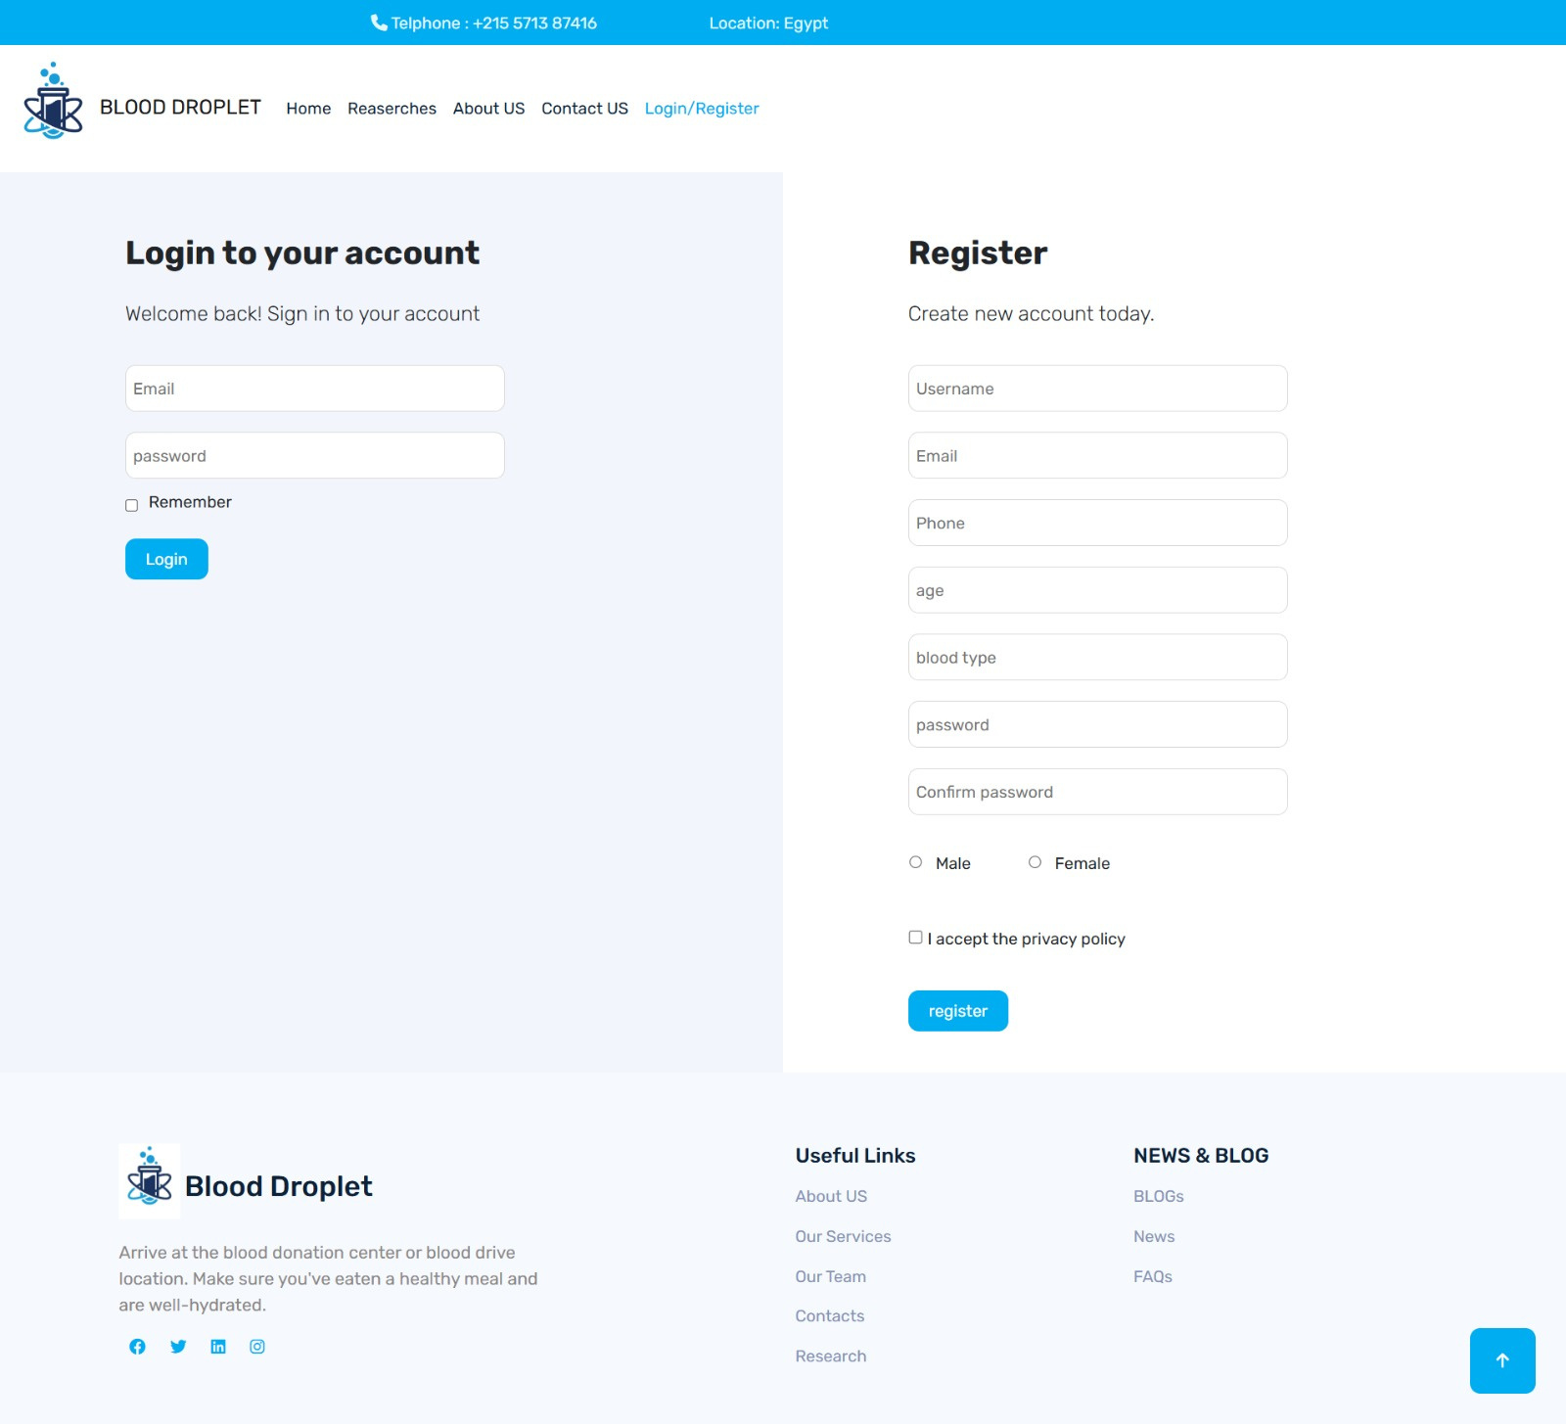
Register
The user enters their username, email, phone, age, blood type, password, and confirms the password. The system verifies the email format and password security. If the email is already registered, an error message is shown. If not, the system hashes the password and inserts the user's details into the database, optionally sending a confirmation email. Based on these steps, the system allows or denies the user's access.

Slide 37

Login
The user enters the email and password, then the system verifies the email and password, and based on that, it allows or denies the user’s access.

Slide 38

Land page
The Blood Droplet landing page features a professional design with a prominent logo, navigation links to essential sections, and contact information.

Slide 39
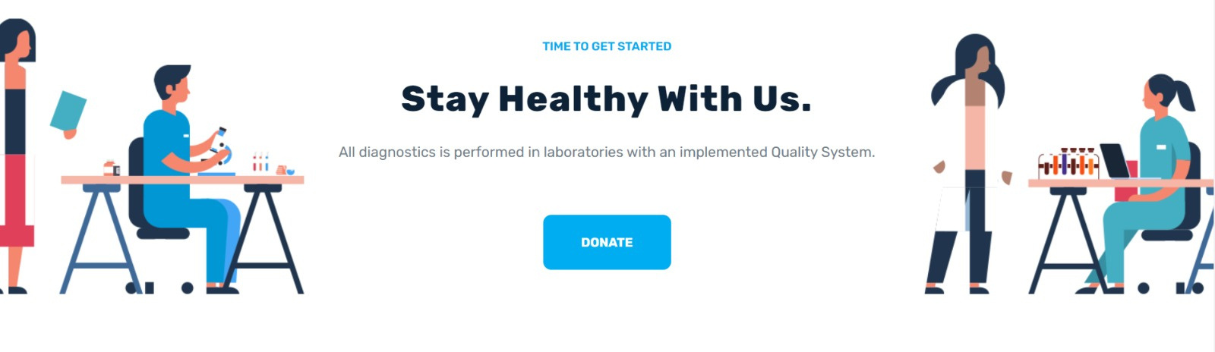
Donation
The user enters the email and password, then the system verifies the email and password, and based on that, it allows or denies the user’s access.

Slide 40
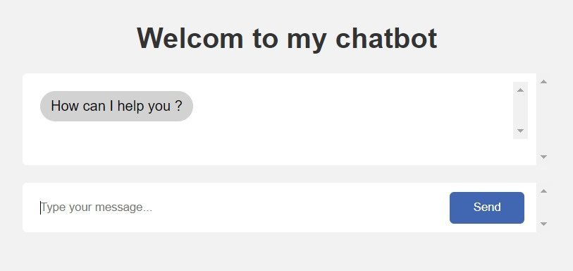
Search
Users, whether patients or donors, can communicate with the chatbot and help them learn about the benefits and importance of blood donation, inquire about symptoms of blood deficiency, etc.

Slide 41

References
1 | https://www.almasryalyoum.com/news/details/2932787
2 | https://www.egyptianrc.org/Arabic/home
3 | https://www.lifeblood.com.au/contact/donate-blood-app
4 | https://play.google.com/store/apps/details?id=com.cube.arc.blood&hl=en_US&pli=1
5 | https://www.redcrossblood.org/blood-donor-app.html
6 | https://www.popai.pro/share.html?shareKey=fa28d5af89c3a07bda8ad9a01724ee5b697fda52ef816830f7dc302af160eec4&utm_source=presentationsharepage
7 | https://www.who.int/ar/news-room/fact-sheets/detail/blood-safety-and-availability

Slide 42


